Slide 1
Boosting Algorithm in Regression

Slide 2
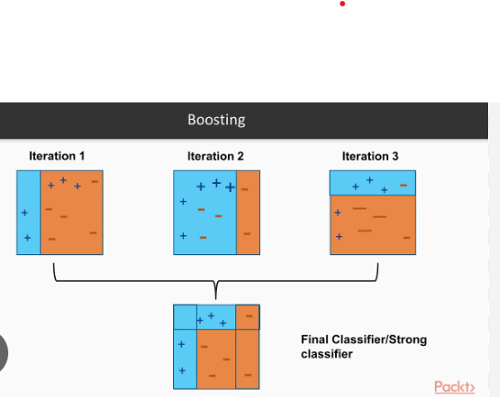
Boosting Algorithm
A Boosting Algorithm Ensemble (grouping ) Technique. This Technique
Encourages Multiple result (with Error) Into Final Results (without Error).

Slide 3
Types of boosting Algorithm
1. Ada Boost
2. XG Boosting
3. LG Boosting

Slide 4
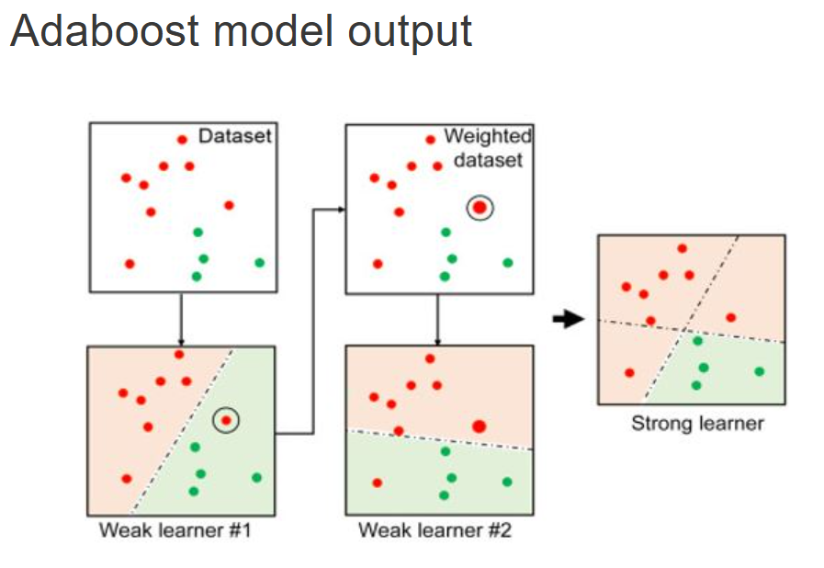
Ada boost regressor
Ada boost Also encourage multiple model results (with error). But it gives more weight With error model results.
finally, less weight for final predictions.

Slide 5
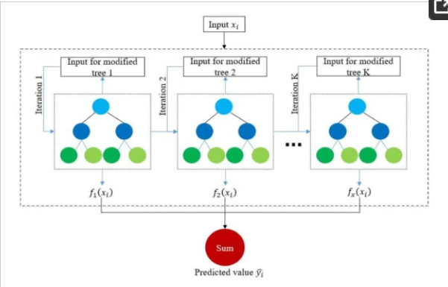
XG boosting (extreme gradient boosting)
XG boost popular in gradient boosting algorithm.
It uses weak regression tree as weak learners. It does sum of weak learning results of prediction.
It also cross validation, compute output of importance.
Metric | Measurement | Target | Actual
Audience attendance | # of attendees | 150 | 120
Engagement duration | Minutes | 60 | 75
Q&A interaction | # of questions | 10 | 15
Positive feedback | Percentage (%) | 90 | 95
Rate of information retention | Percentage (%) | 80 | 85

Slide 6
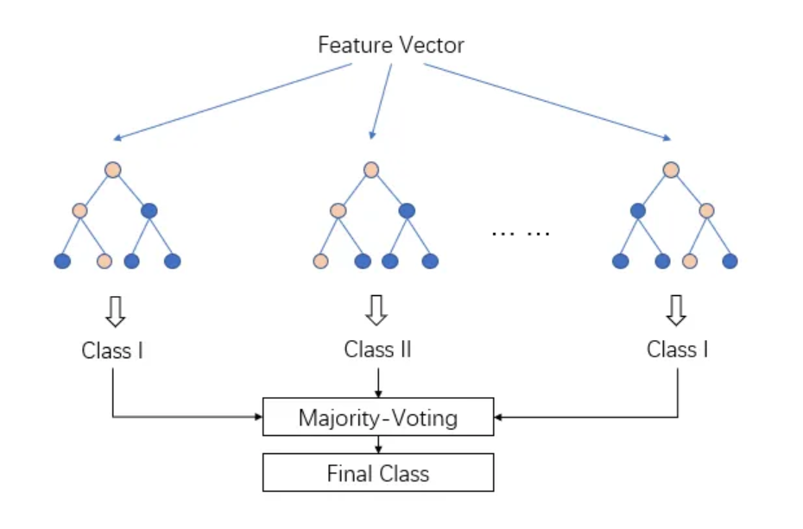
Lg boosting
Its tree based gradient boosting. Leaf wise tree growth not
Depth wise growth.

Slide 7
Thank you
Manoj

